Slide 1
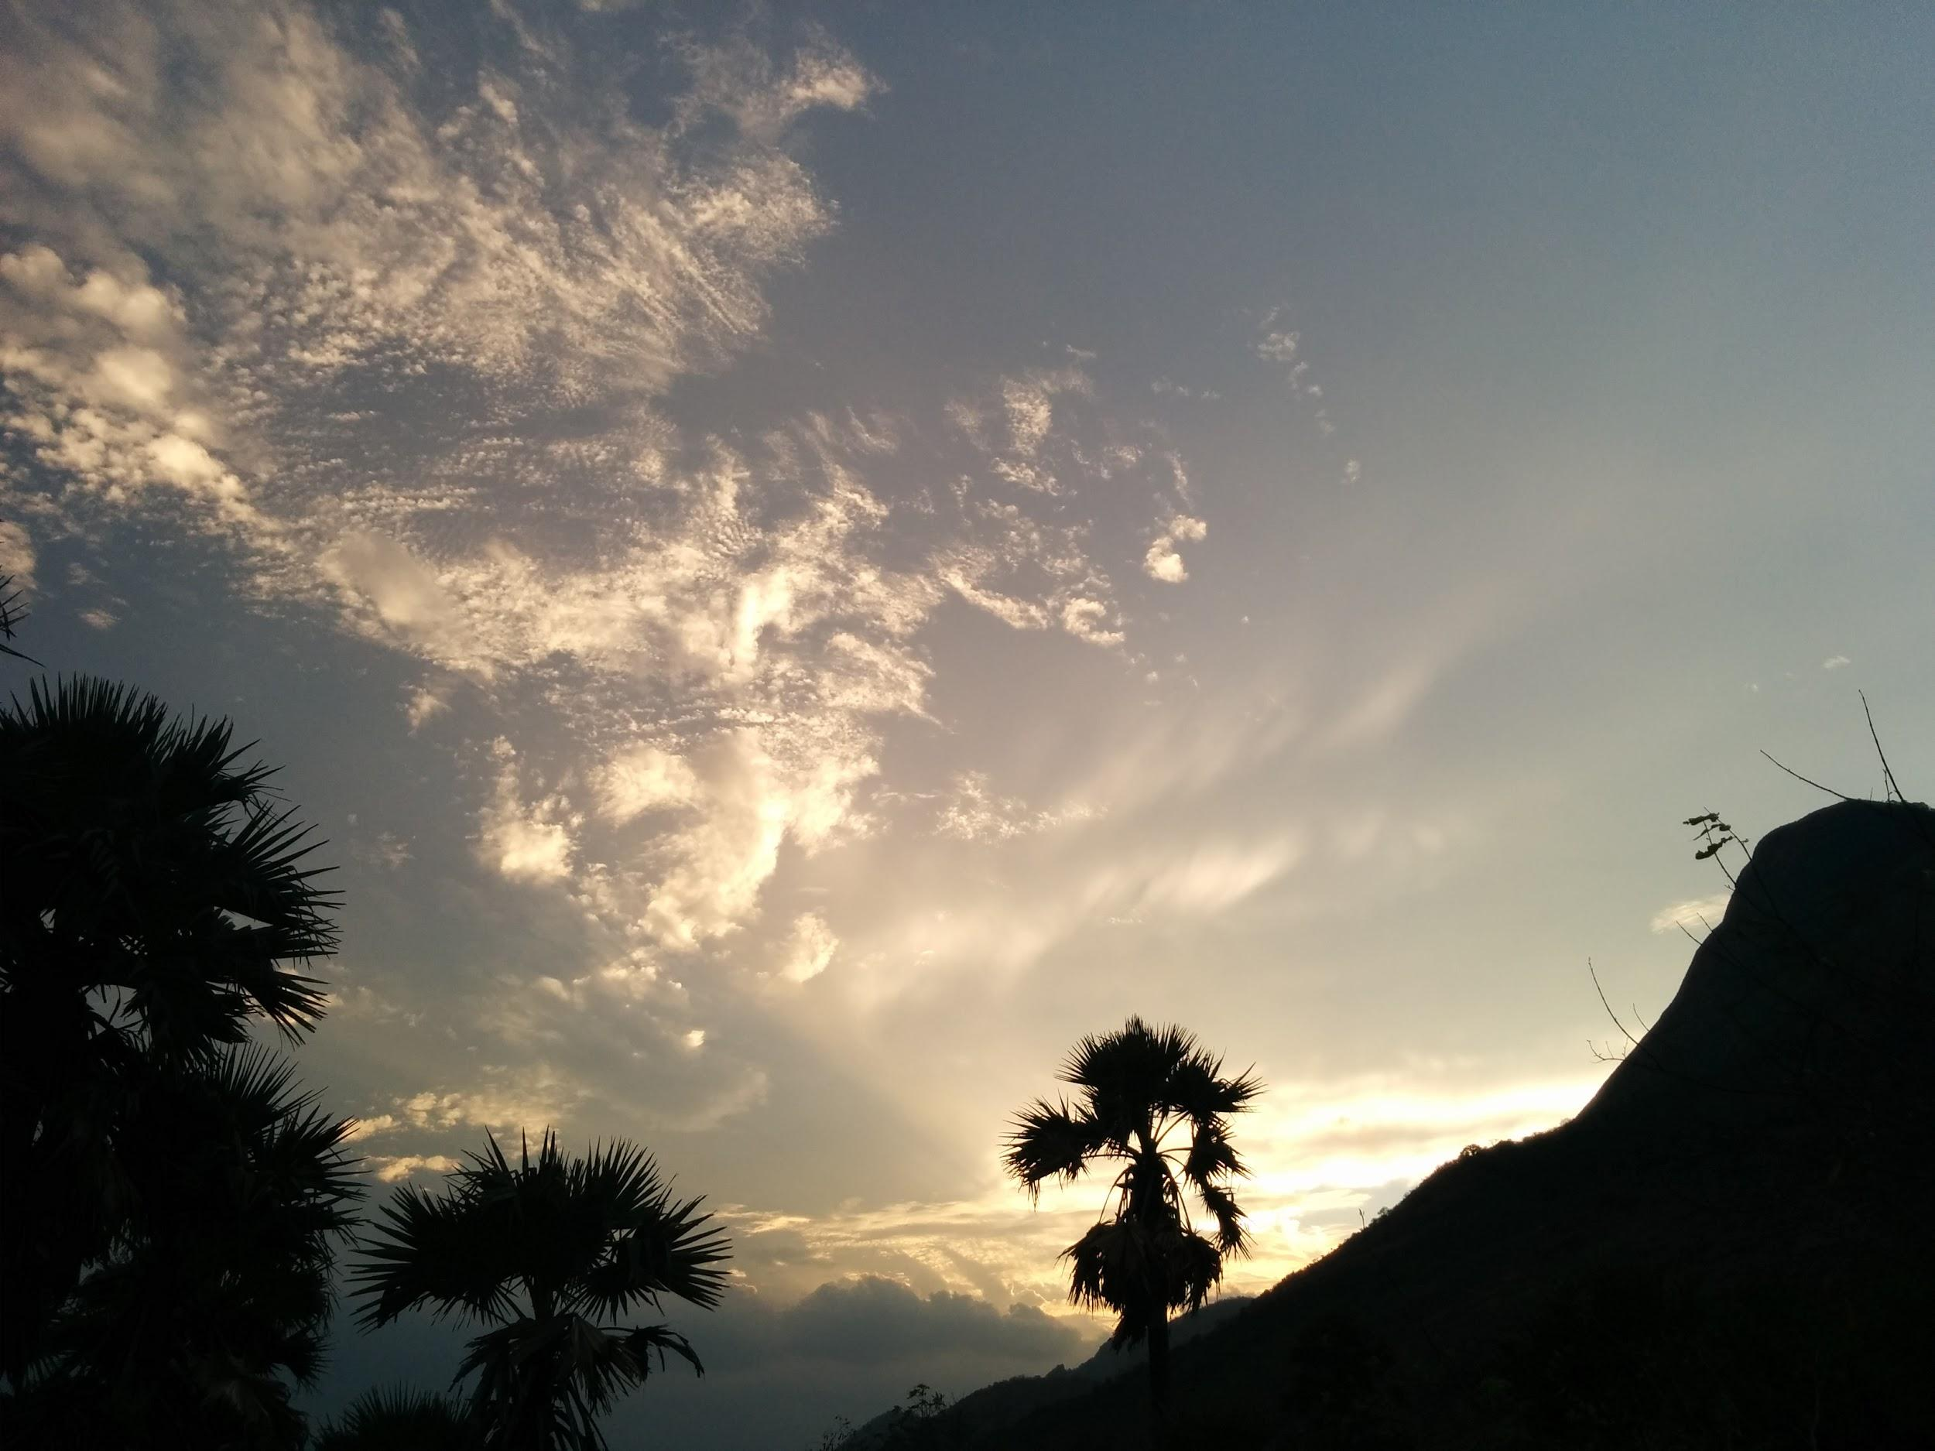

Introduction
ENV300 Environmental Science and Sustainability

Slide 2
Outline
The Nurturing Biosphere
Well-Being and Resource Consumption
Present Unsustainability
Course Description
State of the Environment
Forests
Biodiversity
Water
Ozone layer
Urbanization
Resource depletion, waste and pollution
Consumerism
Climate Change
Perceptions of the Crisis
Causes of the Crisis
Environmental Movement
Sustainable Development

Slide 3
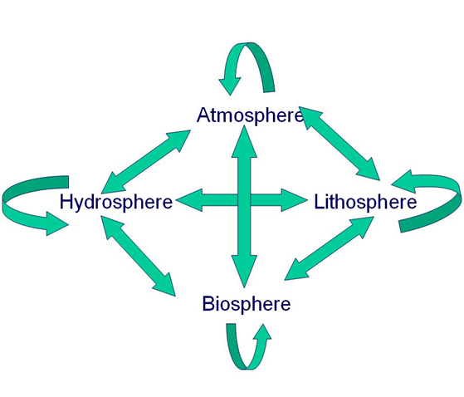

The Nurturing Biosphere
The biosphere is the global ecological system integrating all living beings and their relationships, including their interaction with the elements of the lithosphere, geosphere, hydrosphere, and atmosphere.
Biosphere can also specifically refer to all the living beings on the planet.
Watch Video: Video: She's Alive... (5)

Slide 4
Gaia Theory
By James Lovelock. Gaia: Greek Earth Goddess
Earth with all intricate and interacting systems is like a Super-Organism
Self regulation: chemistry of oceans, atmosphere, temperature, living beings
It appears as if Earth had a purpose...to nurture life and maintain life-friendly conditions.
This perspective brings a new awareness that can enable further evolution of humanity’s understanding of Nature and interactions with it:
When all systems in nature work in order to nurture us, it is in our best interest to design our activities so as to be in harmony with it.
This idea can be the foundation of all future development.
Watch Video: How Wolves Change Rivers (5)

Slide 5
Outline
The Nurturing Biosphere
Well-Being and Resource Consumption
Present Unsustainability
Course Description
State of the Environment
Forests
Biodiversity
Water
Ozone layer
Urbanization
Resource depletion, waste and pollution
Consumerism
Climate Change
Perceptions of the Crisis
Causes of the Crisis
Environmental Movement
Sustainable Development

Slide 6
Consumption, Sustainability and Wellbeing
Humans are the beneficiaries of this dynamic, evolving, nurturing biosphere, which is our HOME.
It sustains us: providing resources for our consumption.
In this beautiful HOME, we would like to survive and achieve well-being into the indefinite future--SUSTAINABILITY.
But our consumption is often continued far beyond survival--OVERCONSUMPTION.
Overconsumption leads to very little improvement in well-being.
But it damages the environment and reduces well-being for others and future generations...UNSUSTAINABILITY

Slide 7
Consumption, Sustainability and Wellbeing
Human well-being is influenced by factors other than consumption
External: family, friends, education, position in society
Internal: identification and fulfillment of one’s purpose in life, realization of spiritual/philosophical truths.
After consuming adequately, further improvement in well-being should be sought through other means.

Slide 8
Consumption, Sustainability and Wellbeing
Many thinkers of our time have realized this and are developing ways to measure well-being in relation to factors other than mere resource consumption.
Quality of life ^{[ref]}
ecology, economics, politics, culture
Human Development Index ^{[ref]}:
life expectancy, education, and income indices.
Happy Planet Index^{[ref]}:
Attained well-being (not necessarily material goods) per unit of extraction or imposition upon nature.
Satisfaction with Life Index ^{[ref]}:
Strong correlation with health, wealth, basic education
Based on asking people how happy they are and social and economic development.

Slide 9
What are the rest of us upto?
Development, economic progress, technological progress...all for improving one’s personal standard of living.
But all this happens at the cost of the environment

Slide 10
Outline
The Nurturing Biosphere
Well-Being and Resource Consumption
Present Unsustainability
Course Description
State of the Environment
Forests
Biodiversity
Water
Ozone layer
Urbanization
Resource depletion, waste and pollution
Consumerism
Climate Change
Perceptions of the Crisis
Causes of the Crisis
Environmental Movement
Sustainable Development

Slide 11
Problem of Unsustainability
The marvellous progress in technology and many fields, has come at a staggering cost.
The scene of modern development is that of simultaneous crises on many fronts.
Environmental crisis:
Earth-threatening environmental problems like Global Warming, Ozone depletion, Deforestation, Desertification, Loss of biodiversity, natural habitats and species, Pollution of food, water, air, land, radioactive pollution
How do we measure our impacts on the environment?

Slide 12
Ecological Footprint
Resources and ecosystem services are provided by Earth through the biogeochemical cycles and the biodiverse ecosystems.
Human activities use up or degrade Earth’s resources, but Earth regenerates/recovers (biocapacity).
Ecological Footprint is the amount of biologically productive land and sea area needed to supply the resources a human population consumes, and to assimilate associated waste.
It is reported in area units.
It attempts to quantify the human demand on the Earth's ecosystems.
Can be calculated for an individual, a family, an organization, a country or the entire human population on the earth.

Slide 13
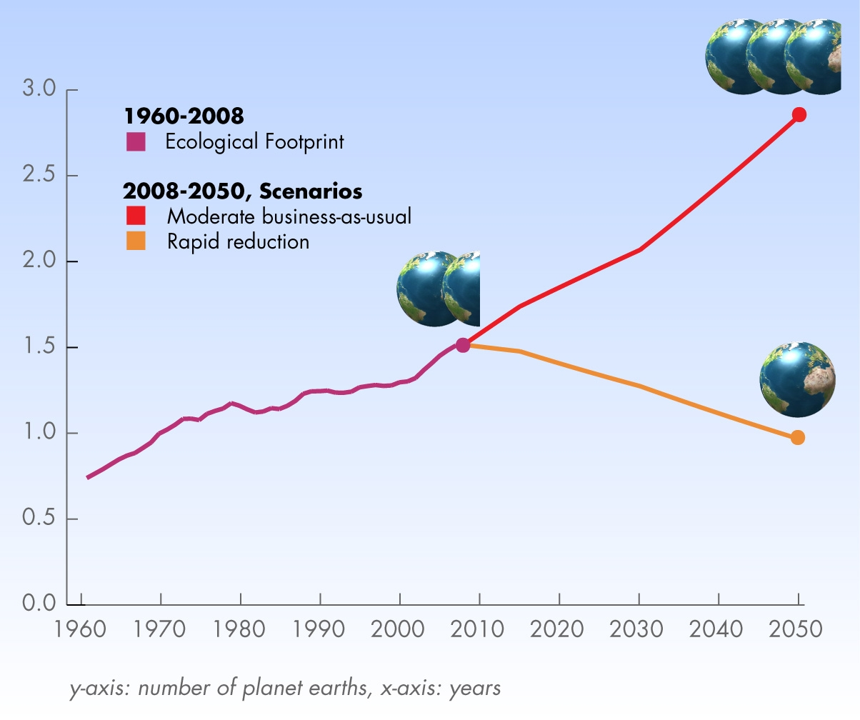
Humanity’s Ecological Footprint
Humanity is using up ecological services 1.5 times as fast as Earth can renew them.^{[2]}
World Footprint www.footprintnetwork.org

Slide 14
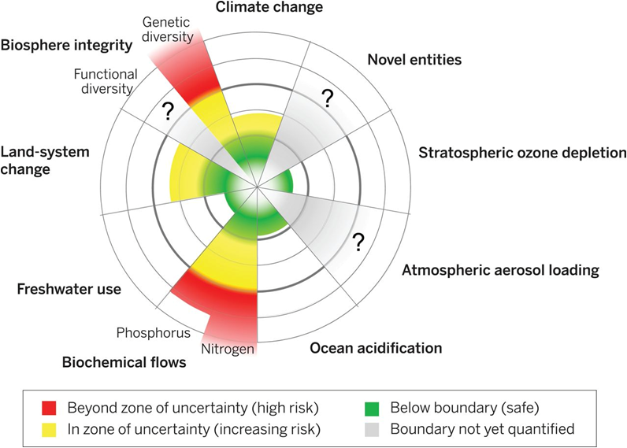

Current status of the control variables for seven of the nine planetary boundaries.The green zone is the safe operating space, the yellow represents the zone of uncertainty (increasing risk), and the red is a high-risk zone. Published by AAAS.
Notes:
Current status of the control variables for seven of the planetary boundaries.The green zone is the safe operating space, the yellow represents the zone of uncertainty (increasing risk), and the red is a high-risk zone. The planetary boundary itself lies at the intersection of the green and yellow zones. The control variables have been normalized for the zone of uncertainty; the center of the figure therefore does not represent values of 0 for the control variables. The control variable shown for climate change is atmospheric CO₂ concentration. Processes for which global-level boundaries cannot yet be quantified are represented by gray wedges; these are atmospheric aerosol loading, novel entities, and the functional role of biosphere integrity.
Why is Climate Change said to be so serious even though it is only in the yellow zone?
The need to address anthropogenic climate change is urgent, and the risks and costs of inaction are increasing. So there is indeed strong consensus that there is very little scope for increasing CO2 emissions much more in future without major impacts on society. The planetary boundaries framework figure plots the current state of individual ‘control variables’ that have been selected from a perspective focused on Earth's biophysical dynamics. It does not plot the societal impact – or even a cross-cutting measure of the environmental impact – of these processes. In other words, the red, yellow and green colours in the figure represent assessments of the risks of Earth system change, rather than direct and immediate risks to people. Anything outside the green ‘safe operating space' represents a rising risk of crossing systemic thresholds. The IPCC’s Fifth Assessment Report provides many visual representations of the impacts of climate change and the risks to people (especially Working Group II). It shows that in the last century, temperature has already changed substantially as a result of greenhouse gas emissions - http://www.climatechange2013.org/images/figures/WGI_AR5_Fig2-21.jpg
Read more:
DOI: 10.1126/science.1259855
Read more about the Planetary Boundaries framework here
Planetary Boundaries Q & A
http://www.stockholmresilience.org/

Slide 15
Problem of Unsustainability
Apart from the environmental crisis, we simultaneously have:
Social crisis:
War, oppression, terrorism, corruption: motivated by control over resources
Growing slums, degrading morality, broken families,
Basic needs: food, clothing and shelter—the very motivation for development—have not been satisfied.
Poverty and hunger.
Individual crisis
Serious health problems: Cancers, heart disease, AIDS, infectious diseases, birth defects, anxiety, stress…

Slide 16
Alas, development, which aims at the survival, and prosperity of humanity, ironically threatens our very existence today.

Slide 17
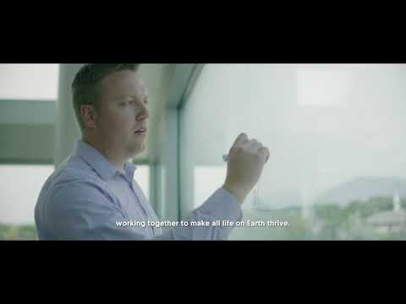
Quote for the Topic
We stand at a critical moment in Earth's history,
A time when humanity must choose its future.
As the world becomes increasingly interdependent and fragile, the future at once holds great peril and great promise.
To move forward we must recognize that in the midst of
A magnificent diversity of cultures and life forms
We are one human family and
one Earth community with a common destiny.
Earth Charter: Turning conscience into action for a thriving Earth. (1.20min)

Slide 18
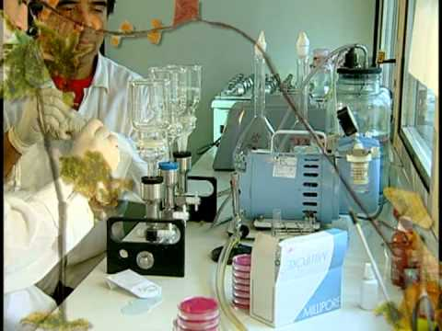
Preamble to the Earth Charter (2000)
We must join together to bring forth
a sustainable global society
founded on respect for nature,
universal human rights, economic justice,
and a culture of peace.
Towards this end, it is imperative that
we, the peoples of Earth,
declare our responsibility to one another,
to the greater community of life,
and to future generations.
The Earth Charter, Values and Principles for a Sustainable Future (23 min)

Slide 19
Outline
The Nurturing Biosphere
Well-Being and Resource Consumption
Present Unsustainability
Course Description
State of the Environment
Forests
Biodiversity
Water
Ozone layer
Urbanization
Resource depletion, waste and pollution
Consumerism
Climate Change
Perceptions of the Crisis
Causes of the Crisis
Environmental Movement
Sustainable Development

Slide 20
Why Study This Course?
Earth-threatening anthropogenic environmental issues
In developed countries, pollution and environmental damage may be less obvious
Shocking state of the environment in India...all around us.
Simultaneous social problems that are deeply intertwined with environmental problems.
You can never even begin to solve a problem unless you first understand the problem and its solution.
The more complex the problem, the deeper your understanding should be.
Education for Sustainability is therefore essential.

Slide 21
Textbooks and Notes
Course Website: https://sites.google.com/site/amritaevs
Course Material is provided on the website.
Reference Books:
R. Rajagopalan “Environmental Studies-From Crisis to Cure”, Oxford University Press.
G.T. Miller Jr., “Environmental Science”, 11th Edition, Cenage Learning India Pvt. Ltd., 2008.
Benny Joseph “Environmental Studies”, Tata McGraw-Hill Publishing Company Limited, 2006.

Slide 22
Teaching Approach
Interactive, Open Discussions, Active Feedback
Class participation is critical
Medium level of difficulty
Attendance is mandatory
Will be required to come up and talk/present frequently.

Slide 23
How To Study for This Course?
Be attentive in class.
Participate in discussions and activities, answer questions when asked by teacher and pose questions to the teacher.
Write notes during the lecture:
Lecture slides are already available to you through the course website, so the content of the slides need not be copied in notebook in class.
Simply write the slide number or slide heading in the margin.
Write details explained or mentioned by the instructor that are not indicated on the slide.
Add any additional points that you notice.

Slide 24
How To Study for This Course?
Must revise everyday; study the slides and your notes together.
Write a 1-2 pg summary of each topic.
Do additional independent reading on each topic.
Independently reflect on the topic, and write down your reflections.
Bring difficulties to the notice of the instructor before it is too late.
Be prepared for the next lecture (questions and surprise tests).

Slide 25
Outline
The Nurturing Biosphere
Well-Being and Resource Consumption
Present Unsustainability
Course Description
State of the Environment
Forests
Biodiversity
Water
Ozone layer
Urbanization
Resource depletion, waste and pollution
Consumerism
Climate Change
Perceptions of the Crisis
Causes of the Crisis
Environmental Movement
Sustainable Development

Slide 26
What is the state of the environment?

Slide 27
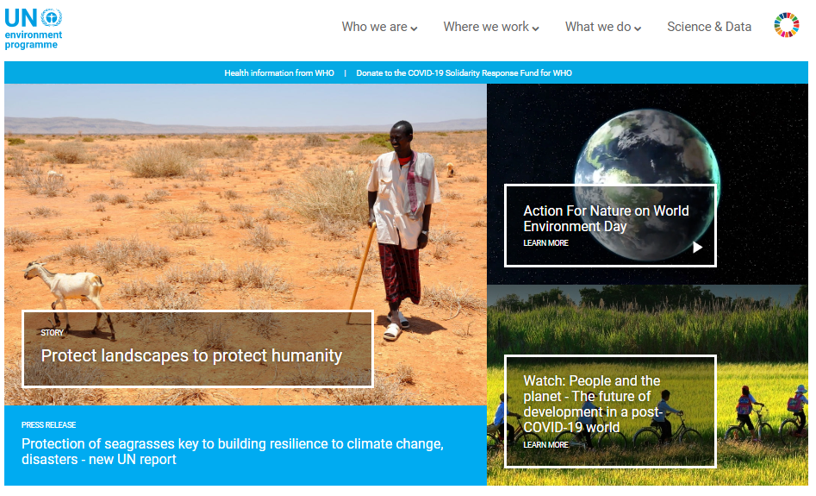
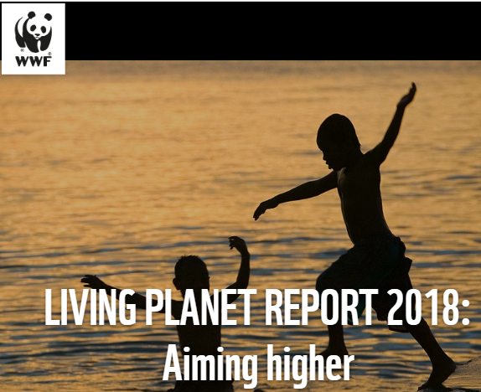
State of the environment: Who tells us?
UNEP: UN Environment Programme
Global Environment Outlook (UNEP)‏
The Living Planet Report WWF

Slide 28
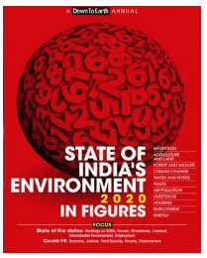
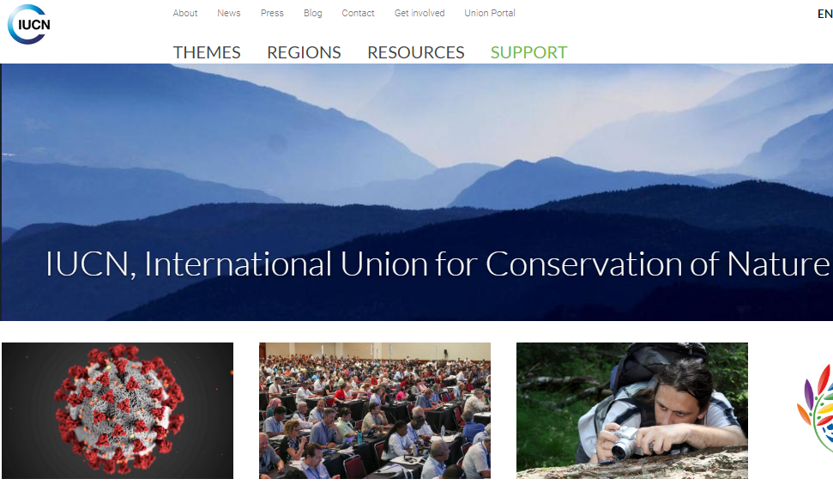
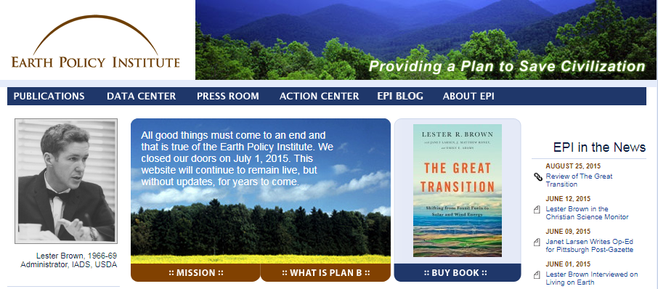
State of the environment: Who tells us?
State of India’s Environment (CSE)‏
World Conservation Union (IUCN)‏
Earth Policy Institute

Slide 29
State of the environment: What are the messages?
Thematic reports (Examples):
World Water Development Report (UN)‏
World Commission on Dams
Intergovernmental Panel for Climate Change
Special reports
UN Millennium Ecosystem Assessment

Slide 30
Upon reading all the various reports, a common story emerges…
The story of what Man has been doing to Nature.
It is a story of many chapters…
Let’s see some of them one by one.

Slide 31
Man first said:
Let us cut all the trees
and
remove the forests!

Slide 32
Outline
The Nurturing Biosphere
Well-Being and Resource Consumption
Present Unsustainability
Course Description
State of the Environment
Forests
Biodiversity
Water
Ozone layer
Urbanization
Resource depletion, waste and pollution
Consumerism
Climate Change
Perceptions of the Crisis
Causes of the Crisis
Environmental Movement
Sustainable Development

Slide 33
Once upon a time,
about 2500 years ago, on a small island, in the Pacific, people actually cut down all the trees.
They also made…

Slide 34
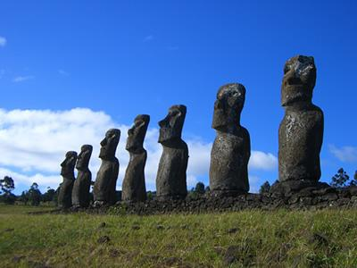

Slide 35
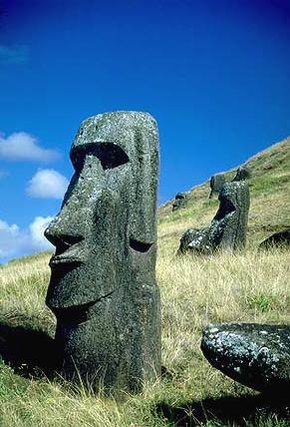
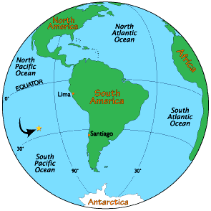

Slide 36
Easter Island
Colonised 2500 years ago by Polynesians
1400 AD: Population of 20,000
Large stone sculptures
Palm trees used up, none left
No more boats, fish
Water runoff, drought, famine
Conflicts over resources, collapse
1722 AD: Dutch explorers found just 2000 famished people on barren island !

Slide 37
Can Easter Island happen again?
No,
Easter Island is an old story,
we are wiser today !
Are we ?

Slide 38
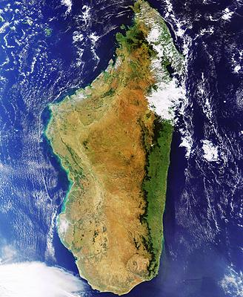

Slide 39
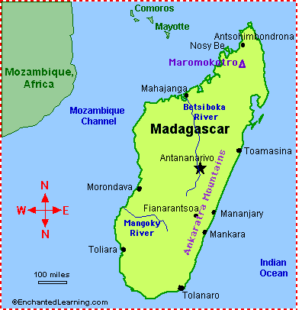

Slide 40
Madagascar
40 million years in isolation
Astonishing biodiversity
85 % species endemic
Humans arrived 1500 years ago
80 % of forests destroyed, soil erosion
Most species endangered
50 % may go extinct by 2025

Slide 41
Easter Island and Madagascar
are far away,
surely it cannot happen in India!

Slide 42
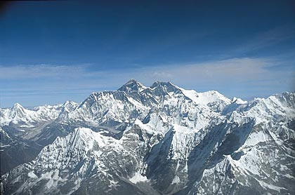

Slide 43
The Himalayas
Responsible for India’s monsoon
Source of many rivers
Had 40 % forest cover
Immense biodiversity
Metal deposits
50 million people in the region

Slide 44
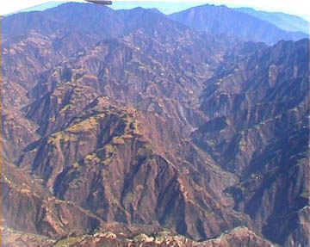
Himalayas laid bare: severe deforestation and denudation

Slide 45
The Himalayas in peril
Deforestation:
Landslides, soil erosion, floods
Projects and road building:
More exploitation, ecosystems affected
Mountaineering:
Garbage, heavy movement, resource depletion
GLOBAL WARMING: GLACIERS ARE MELTING

Slide 46
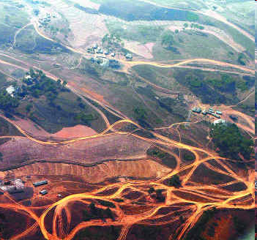
Modern Artwork of Crisscrossing Roads in the Himalayas Replaces Nature’s Art

Slide 47
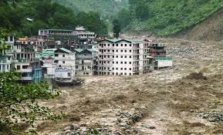
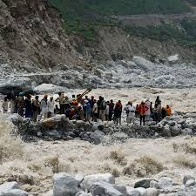
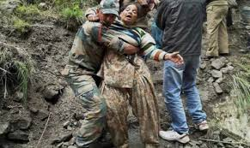
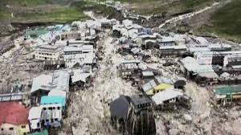
Result: The Uttarakhand Disaster
Nature avenges its exploitation
There is little doubt that the present Himalayan disaster has been triggered by natural events, but the catastrophe is man-made. --The Hindu

Slide 48
Forests
More than 50 countries have lost between 90 and 100 per cent of their forests
Tropical forests are being cleared at the rate of one hectare every second.

Slide 49
Outline
The Nurturing Biosphere
Well-Being and Resource Consumption
Present Unsustainability
Course Description
State of the Environment
Forests
Biodiversity
Water
Ozone layer
Urbanization
Resource depletion, waste and pollution
Consumerism
Climate Change
Perceptions of the Crisis
Causes of the Crisis
Environmental Movement
Sustainable Development

Slide 50
Man felt so powerful. He thought:
Let us kill birds, tigers, elephants,
all other life forms,
and cause
the Sixth Mass Extinction of species !

Slide 51
Biodiversity
World:
24% mammals, 12% birds, 25% reptiles, 30% fish threatened or endangered
100-1000 times faster than natural process of extinction
India:
> 10% flora and fauna are threatened, many on verge of extinction

Slide 52
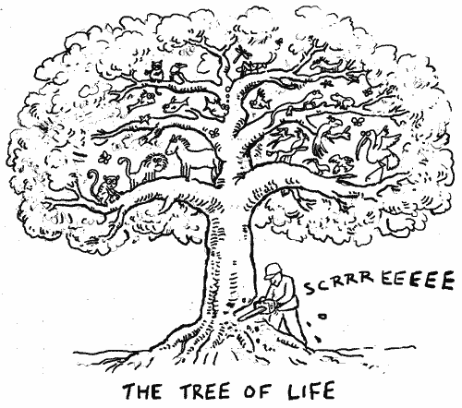

Slide 53
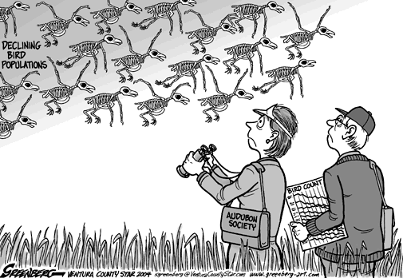

Slide 54
Outline
The Nurturing Biosphere
Well-Being and Resource Consumption
Present Unsustainability
Course Description
State of the Environment
Forests
Biodiversity
Water
Ozone layer
Urbanization
Resource depletion, waste and pollution
Consumerism
Climate Change
Perceptions of the Crisis
Causes of the Crisis
Environmental Movement
Sustainable Development

Slide 55
Man continued:
Let us extract all the groundwater,
pollute all the waterways,
exploit the oceans and coastal space!

Slide 56
Water
The per capita availability of freshwater is declining globally.
Contaminated water remains the greatest single environmental cause of human sickness and death.
The decline of quantity and quality of surface and groundwater is impacting aquatic ecosystems and their services.
By 2025, 1.8 billion people will be living in countries or regions with absolute water scarcity, and two-thirds of the people in the world could be subject to water stress.

Slide 57
Water
World:
80 countries of the world suffer from serious water shortages:
1.5 billion people, one fourth of the population, have no access to safe drinking water.
Half the population lacks sanitation facilities.
India:
No drinking water in > 60,000 villages
Diarrhoea kills one million children per year
45 million affected by bad water per year

Slide 58
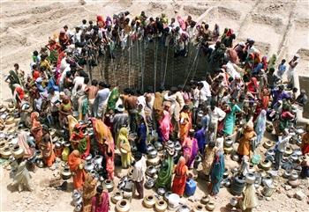

Slide 59
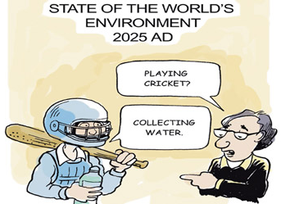

Slide 60
Oceans, Rivers, and Fisheries
Aquatic ecosystems continue to be heavily exploited, putting at risk sustainability of food supplies and biodiversity.
Global marine and freshwater fish catches show large-scale declines, caused mostly by persistent overfishing.
No fish to catch, by 2050 ?

Slide 61
State of the Coast
The average population density in coastal areas is now twice as high as the global average.
More than 100 million people live in areas no more than one metre above mean sea-level.
21 of the world’s 33 mega-cities are located in coastal areas, with most of them in developing countries.

Slide 62
State of the Coast
Poor planning,
the loss of key ecosystems such as wetlands, mangroves and coral reefs, and
sea level rise due to climate change,
are increasing the risk of flooding and reducing coastal protection from storms, tsunamis and erosion.

Slide 63
Coastal/Marine Degradation
World:
Marine pollution has increased enormously.
World fisheries have collapsed due to overexploitation and pollution.
India:
50% of mangroves and corals lost
Heavy sea erosion, sea water intrusion

Slide 64
Outline
The Nurturing Biosphere
Well-Being and Resource Consumption
Present Unsustainability
Course Description
State of the Environment
Forests
Biodiversity
Water
Ozone layer
Urbanization
Resource depletion, waste and pollution
Consumerism
Climate Change
Perceptions of the Crisis
Causes of the Crisis
Environmental Movement
Sustainable Development

Slide 65
Man said:
Let us be cool, use CFCs,
and
blow a big hole in the ozone layer !

Slide 66
Ozone Hole
The “hole” in the stratospheric ozone layer over the Antarctic is now the largest ever.
Due to decreased emissions of ozone depleting substances and assuming full Montreal Protocol compliance, the ozone layer is expected to recover, but not until 2060 (or even later).

Slide 67
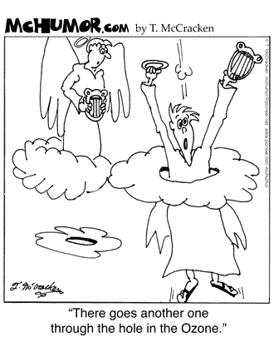

Slide 68
Outline
The Nurturing Biosphere
Well-Being and Resource Consumption
Present Unsustainability
Course Description
State of the Environment
Forests
Biodiversity
Water
Ozone layer
Urbanization
Resource depletion, waste and pollution
Consumerism
Climate Change
Perceptions of the Crisis
Causes of the Crisis
Environmental Movement
Sustainable Development

Slide 69
Man also had a great idea:
Let us create big cities
and
we can live happily !

Slide 70
Our Urban Future
An Urbanizing World
Increase in urban population:
From 732 million in 1950 to 3.2 billion in 2006.
Half the world population is in cities (from 2008)‏
Asia and Africa to double their urban populations to roughly 3.4 billion by 2030.

Slide 71
Urban Woes
Roughly half the people in African and Asian cities lack adequate water and sanitation.
6 of the 10 are vulnerable to storm surges.
Eight of the world’s 10 most populous cities sit on earthquake faults
Urban air pollution kills an estimated 800,000 people each year, roughly half of them in China
Each year, traffic accidents kill about 1.2 million people and injure up to 50 million more.

Slide 72
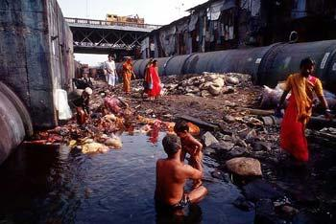

Slide 73
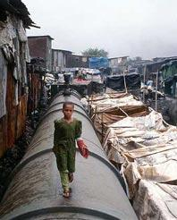

Slide 74
Outline
The Nurturing Biosphere
Well-Being and Resource Consumption
Present Unsustainability
Course Description
State of the Environment
Forests
Biodiversity
Water
Ozone layer
Urbanization
Resource depletion, waste and pollution
Consumerism
Climate Change
Perceptions of the Crisis
Causes of the Crisis
Environmental Movement
Sustainable Development

Slide 75
Then Man said:
Let us use up all the natural resources, convert them to waste,
and dump it or
pollute the air and water !

Slide 76
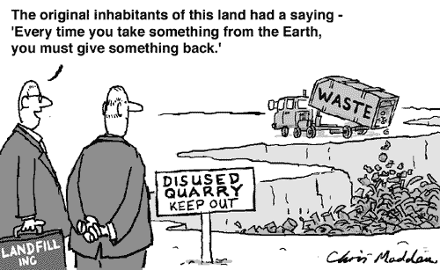

Slide 77
Air Pollution
At least one billion people in the world breathe unhealthy air.
More than 2 million people globally die prematurely every year due to outdoor and indoor air pollution.
Although air pollution has decreased in some cities in the North, emissions are increasing in many cities of the South.
Indoor air pollution due to the improper burning of solid biomass fuels imposes an enormous health burden.
Indian cities among the most polluted in the world.

Slide 78
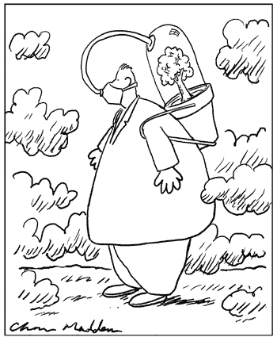
Can you interpret this cartoon?

Slide 79
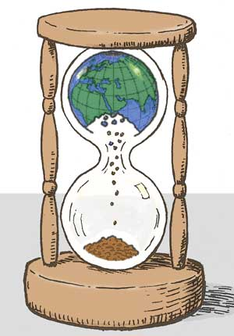
Can you interpret this cartoon?

Slide 80
Outline
The Nurturing Biosphere
Well-Being and Resource Consumption
Present Unsustainability
Course Description
State of the Environment
Forests
Biodiversity
Water
Ozone layer
Urbanization
Resource depletion, waste and pollution
Consumerism
Climate Change
Perceptions of the Crisis
Causes of the Crisis
Environmental Movement
Sustainable Development

Slide 81
Man in essence said:
Let us consume more and more
and
we will all be happy !

Slide 82

Can you guess what this is?

Slide 83
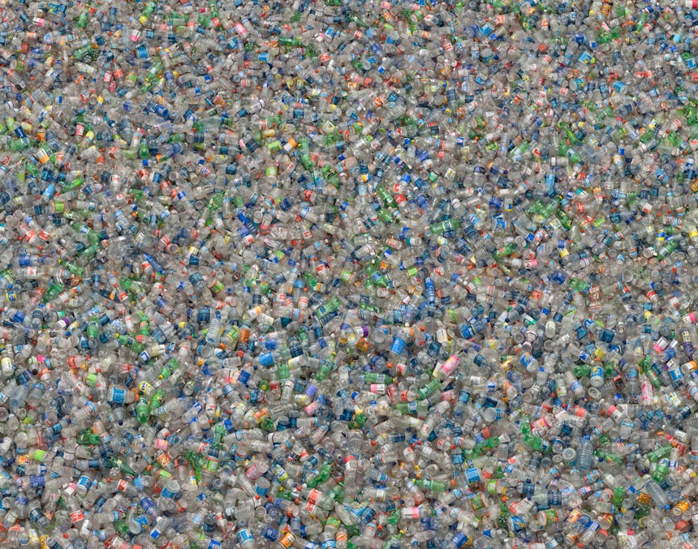
How about now?

Slide 84
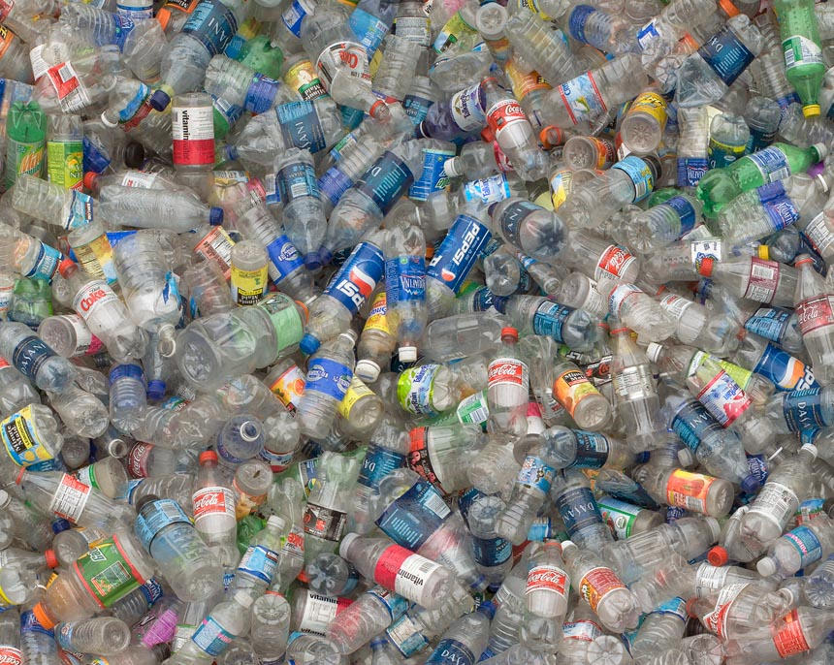
Certainly now, it is obvious!!

Slide 85
Art by Chris Jordan
Plastic Bottles, 2007
60” x120" Depicts two million
plastic beverage bottles,
the number used in the US
every five minutes.

Slide 86
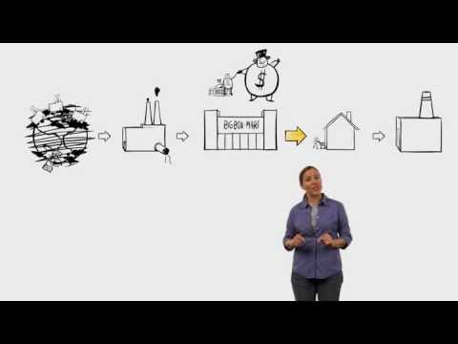
Consumerism
Consumerism has become a way of life for us.
Let’s learn more about what happens to the stuff we buy, consume and throw.
Let’s watch the video: The Story of Stuff (21) or read the transcript

Slide 87
Outline
The Nurturing Biosphere
Well-Being and Resource Consumption
Present Unsustainability
Course Description
State of the Environment
Forests
Biodiversity
Water
Ozone layer
Urbanization
Resource depletion, waste and pollution
Consumerism
Climate Change
Perceptions of the Crisis
Causes of the Crisis
Environmental Movement
Sustainable Development

Slide 88
Things are warming up !
Global warming is happening:
The Arctic is melting.
Antarctic ice shelves are breaking off.
The weather is becoming unpredictable.
The frequency of natural disasters and the number of people affected are increasing.
Sea level rise is threatening the existence of small islands.
India: The Himalayan glaciers are receding !

Slide 89
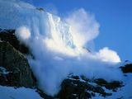
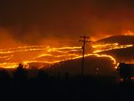
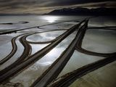
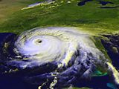
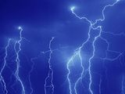
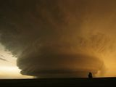
Climate Change Worsens Natural Disasters
Avalanches, Snowstorms, Landslides
Wildfires
Floods, Droughts, Famines
Storms
Lightning
Tornadoes
Note: The above disasters can get worse due to climate change

Slide 90
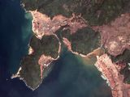
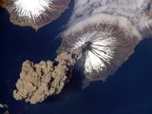
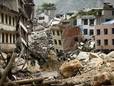
Increased Damage from Natural Disasters
Due to:
Uncontrolled urbanization
High population density
Poor planning and preparedness
Tsunamis
Earthquakes
Volcanoes
Note: The above disasters are not related to climate change

Slide 91
We are past the tipping point
in many aspects of the environment !
It may all come together as a catastrophe
by 2030-35.

Slide 92
Of course, as we saw before, it is not environment alone
Interconnected things:
Increasing population, food prices
Increasing disparities:
Marginalisation of the poor
Farmers in distress
Increasing militarisation, terrorism
Large scale corruption, frauds
Financial crisis, economic ups and downs.

Slide 93
Outline
The Nurturing Biosphere
Well-Being and Resource Consumption
Present Unsustainability
Course Description
State of the Environment
Forests
Biodiversity
Water
Ozone layer
Urbanization
Resource depletion, waste and pollution
Consumerism
Climate Change
Perceptions of the Crisis
Causes of the Crisis
Environmental Movement
Sustainable Development

Slide 94
Is Unsustainability Really a Crisis?
Different Perceptions
Environmental problems are not as bad as they are made out to be.
There are problems, but S&T will find solutions.
There is a real crisis, the wolf is at the door, there is no way out !
Hunger and poverty are more important issues, we need economic growth.
It is all part of a Grand Design. God made this world, and He will take care of it.
The Earth is a self-evolving and self-regulating living system and it will survive (Gaia Theory).

Slide 95
Human beings and
the natural world
are on a collision course.
World Scientists’ Warning to Humanity
So, it is much worse than I imagined !

Slide 96
Changes are coming !
Within your lifetime, you will see
major environmental and social changes.
They will not be pleasant
for you, your children, and humanity.
You can, however, mitigate the impact
by taking action NOW.
There is no time to lose !

Slide 97

Wait a minute,
Were we not living happily
for thousands of years?
Why is there a crisis now?

Slide 98
Earth, Nature, Man: The Long View
We have survived for so long:
Earth: 5 billion years
Man: 3 to 5 million years
Civilization: 10,000 years
We know:
Nature absorbs disturbances !
Man is the master !
S&T can solve all problems !
Economic development is the key.

Slide 99

Why can’t we continue the same way?
Or, is something different happening now?

Slide 100
Outline
The Nurturing Biosphere
Well-Being and Resource Consumption
Present Unsustainability
Course Description
State of the Environment
Forests
Biodiversity
Water
Ozone layer
Urbanization
Resource depletion, waste and pollution
Consumerism
Climate Change
Perceptions of the Crisis
Causes of the Crisis
Environmental Movement
Sustainable Development

Slide 101
Examine the graphs on the next four slides…

Slide 102
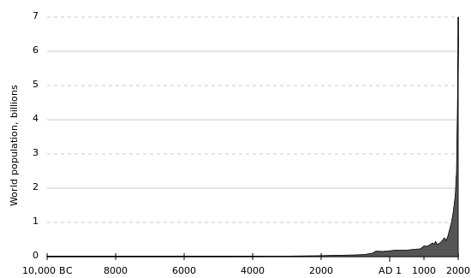
The Population Spike

Slide 103
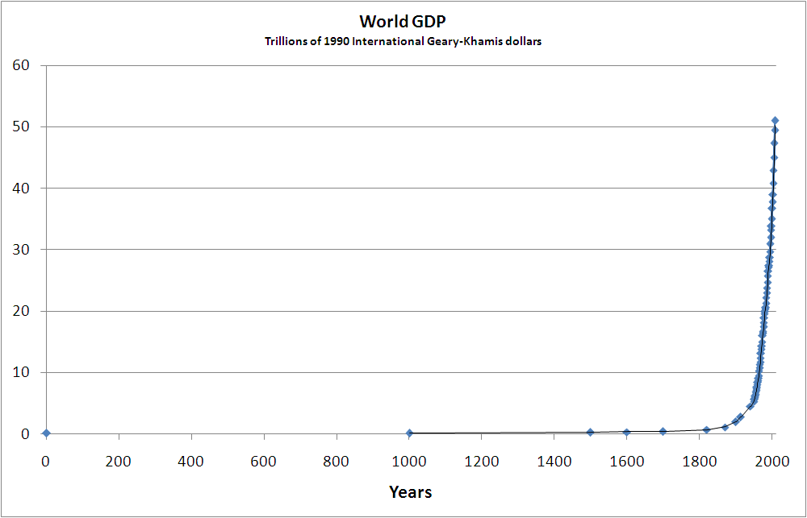
The Consumption Spike
Plotted from the Data of “Historical Statistics of the World Economy: 1-2008 AD” Angus Maddison

Slide 104
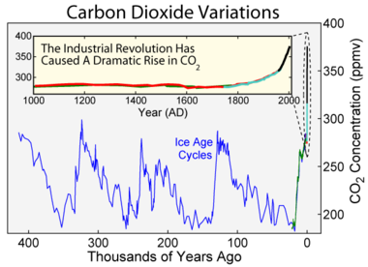
The CO₂ Spike

Slide 105
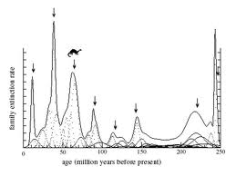
The Extinction Spike

Slide 106
Anyone who believes that exponential growth can go on forever in a finite world is
either a madman or an economist.
- Kenneth Boulding

Slide 107
But don’t we all want growth?
That is what our politicians, industrialists and economists are striving for.
Why do we have to question
‘economic growth’ and ‘development’ ?
We certainly don’t have to give up development. But we do have to think of development differently...very differently.

Slide 108
Why do the spikes occur?

Slide 109
GROWTH AND DEVELOPMENT
The Idea of Progress
16th/17th Century Europe
Industrial Revolution
New attitude towards nature
Man is most important
Nature is for exploitation
Exponential growth in many areas
Supported by Science & Technology

Slide 110
Let’s understand present sustainability through a model...

Slide 111
Unsustainability is a Tragedy of the Commons (Open Access Resources)
The degradation of a common shared resource (commons) is inevitable in the long term when:
The sharing individuals are rational and self-interested (profit-minded).
Its use is unregulated.
The benefits of increased consumption are immediate and privately enjoyed, while the degradation of the resource is delayed and is distributed among all.
So, consumption goes on increasing until the resource degrades...
The socio-environmental crisis is a greatly magnified Tragedy of the Commons.
Garrett Hardin, 1968 Science 162 (3859): 1243–1248. doi:10.1126/science.162.3859.1243.PMID 5699198.

Slide 112
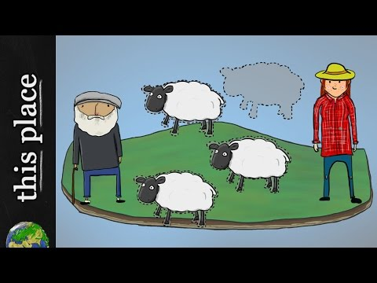
Watch Video: Tragedy of the Commons │ The Problem with Open Access (3.26 min)

Slide 113
Outline
The Nurturing Biosphere
Well-Being and Resource Consumption
Present Unsustainability
Course Description
State of the Environment
Forests
Biodiversity
Water
Ozone layer
Urbanization
Resource depletion, waste and pollution
Consumerism
Climate Change
Perceptions of the Crisis
Causes of the Crisis
Environmental Movement
Sustainable Development

Slide 114
What has the world done about it?
Rachel Carson: Silent Spring (1962)
Environmental movement
Stockholm Conference (1972)
UNEP, UN Conventions & Agreements
Earth Summit, Agenda 21 (1992)
World Summit on Sust. Development (2002)
Intergovernmental Panel on Climate Change, Kyoto Protocol

Slide 115
What has India done about it?
Initial legislation: Water Act, etc.
Post-Bhopal: Many laws
Environment Protection Act, 1986
MoEF, Pollution Control Boards
Environmental Impact Assessment
Rise of civil society
Yet, environmental degradation
continues unabated !

Slide 116
Is there no hope, then?
If things are so bad and disaster is imminent, should I just give up?
No, I must find out
the real enemy of the environment !

Slide 117
Who is responsible?
My neighbour who throws the garbage on the street?
Rich countries like the US that consume and pollute a lot?
Companies that use natural resources and throw away the waste?
Corrupt officials who let the companies pollute?
Municipalities that do not clear the garbage?
Overpopulation? But it only amplifies what is basically wrong.
Politics or the ‘system’? But, in a democracy, don’t we make the system?

Slide 118
Who is responsible?
Don’t say that you have nothing to do with it; you are party to it and also the sufferer.
Don’t say you are helpless and insignificant; small steps make big impacts.
I am responsible for the damage and for bringing change.

Slide 119
Our Attitudes and Actions are the Cause
My consumption
The waste that I create and throw away
NIMBY (Not In My BackYard) syndrome
The corruption that I support, directly or indirectly
The unsustainable or polluting nature of my work, my organization

Slide 120
So, I am now part of the problem !
Can I become a part of the solution ?

Slide 121
Yes!
We are the ones
we have been waiting for!
June Jordan
I am the real cause of the problem
so I have to begin with myself !

Slide 122
Fine. I’m ready to do what it takes.
But what am I supposed to do?
What are WE supposed to do?
We all need to work towards:
SUSTAINABLE DEVELOPMENT

Slide 123
Outline
The Nurturing Biosphere
Well-Being and Resource Consumption
Present Unsustainability
Course Description
State of the Environment
Forests
Biodiversity
Water
Ozone layer
Urbanization
Resource depletion, waste and pollution
Consumerism
Climate Change
Perceptions of the Crisis
Causes of the Crisis
Environmental Movement
Sustainable Development

Slide 124

Sustainable Development (SD)
SD is the economic development to meet human needs while preserving the environment.
Meet needs into the indefinite future.
Present economic growth is unsustainable since it leads to social inequities and environmental damage.
Economy, Society, Environment: 3 interdependent and mutually reinforcing pillars of SD.

Slide 125

UNEP’s Sustainable Development Goals (SDGs)

Slide 126
In order to work towards Sustainable Development, we need to learn a lot of things….
We need to study this course for starters!
So, let’s get on with it!

Slide 127

Thank You
Look forward to learning more about our wonderful environment with you…

